Slide 1
Word List: vit, viv
= live, life

Slide 2
to bring back to life again

Slide 3
revive
to bring back to life again

Slide 4
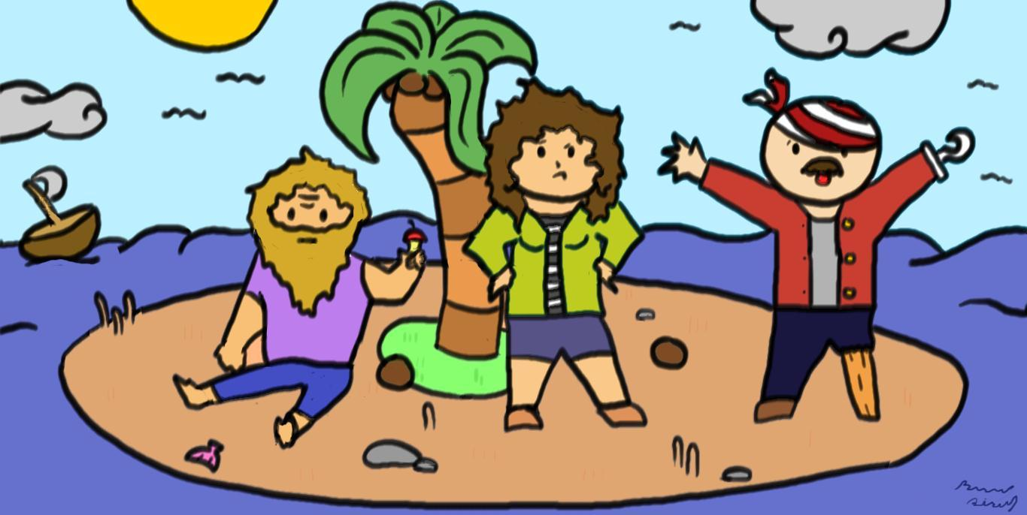
the ability to continue living

Slide 5
survival
the ability to continue living

Slide 6
to bring something back after it declined in condition or popularity: to breathe new life into something

Slide 7
revitalize
to bring something back after it declined in condition or popularity: to breathe new life into something

Slide 8
a person who lives through a difficult event or experience

Slide 9
survivor
a person who lives through a difficult event or experience

Slide 10
necessary or essential to life

Slide 11
vital
necessary or essential to life

Slide 12
a tablet of substances that are thought to promote a healthy life

Slide 13
vitamin
a tablet of substances that are thought to promote a healthy life

Slide 14
full of life; fun; lively; animated

Slide 15
vivacious
full of life; fun; lively; animated

Slide 16
surgery on living animals; medical research that involves cutting into animals to study organs, parts, or diseases

Slide 17
vivisection
surgery on living animals; medical research that involves cutting into animals to study organs, parts, or diseases

Slide 18
quality or state of being full of life; state of being full of energy

Slide 19
vitality
quality or state of being full of life; state of being full of energy

Slide 20
as big as life; brightly colored; daring

Slide 21
vivid
as big as life; brightly colored; daring

Slide 22
END!

